Slide 1
PREPARATION – DELETE BEFORE MEETING
Fill in the following:
Slide 2:
Enter the “Presented By: Name, Title, Company” with your information
Replace the “Your Logo Here” logo with your company logo
Slide 3:
Fill this slide out with your personal information as well as your Company information
Slide 4
Nothing to fill in here. This is where you will explain the importance of an MSP and the risks associated with not having proactive managed services.
Slide 5
Here you will replace the SRA Threat Chart with your client’s chart.
Slide 7
THE PITCH. It’s time to pitch your MSP services, focus on the benefits, and how you can help them. Format the slide as you see fit and tailor it to your specific offering. Here you will fill in their top 3 risks, or the top 3 that align best with your service. Also fill in what service you provide to help them lower that risk. Now go out there and CLOSE!
TIPS:
PRACTICE – run through the deck multiple times
Focus on the impact to their business, not the stats or the technology
Be relatable and have talking points
Don’t read right off the slides.

Slide 2
WHAT ARE YOUR BLINDSPOTS? TECHNOLOGY HAS OUR BACK WHEN HUMANS MAKE MISTAKES
PRESENTED BY:
[NAME, TITLE, COMPANY]

Slide 3
WHO AM I?
[Your name and job title]
[Brief speaker biography]
[Note some personal tidbits, get personal and real with your prospects]
One hobby or activity
[Company Name]
[Brief company biography]
Security-focused
We pride ourselves on helping small to mid-size businesses strengthen their security posture and protect them from cybertheft.

Slide 4
WHAT IS A MANAGED SERVICE PROVIDER?
A Managed Service Provider (MSP) is a third-party IT service company that manages and maintains your network, applications, and systems on a proactive basis.
Risks of not having a robust MSP
Lack of security to fall back on if an employee makes a mistake.
Nobody is maintaining your network.
Not having a plan to respond to an incident leads to long downtime.
Notes:
What do MSPs do?
- MSPs are intended to help improve operations and reduce expenses.
- By having a Managed Service Provider, your organization can focus on improving your services without having to worry about interruptions.
- Proactive monitoring of networks, applications, and other systems is necessary to keep them stable and reliable.
RISK of not having a robust MSP – Below are reasons these risks are important
Continuous security monitoring, implementation, and focus lowers the risk of data breaches.
- If an employee makes a mistake, you need security to protect not only your network but your company assets and to recover from an incident.
Having nobody to maintain your network is like not performing maintenance on your car. If you stop maintaining your car, it WILL stop running.
Having an MSP will help you ensure your network (applications, systems, etc.) are maintained. For example, continuous patching – If you’re not ensuring patches are being performed when needed, you’re leaving your computers/network vulnerable. MSPs can help make sure you’re getting the maintenance when you need I
If you don’t have a plan for how you’re going to handle or respond to an incident or data breach once it occurs, your organization could end up with long downtimes leading to loss of revenue.
- MSPs can help you prepare for an incident and make sure all the appropriate security/backup measures are in place to decrease downtime and keep you up and running if an outage or incident occurred.

Slide 5
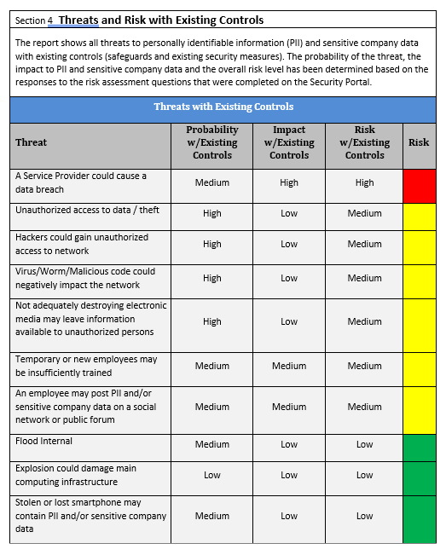
YOUR SECURITY RISK ASSEMENT
How we performed your Security Risk Assessment
Enter first
highest
threat
Services to lower risk
Enter second
Highest
threat
Services to lower risk
01
02
Enter third
Highest
threat
Services to lower risk
03
Notes:
Map MSP services to threats/findings & recommendations.
This is your time to pitch your service and really drive the point home that you can help remediate these risks.
- Offer to give a proposal for MSP services
Box compares finding → services (table)
Drill into findings and recommendations.
Here, you want to highlight their high/medium risks or the ones that map best to your MSP services.
Ensure they understand the risk to their business if the recommendations go ignored, but also make sure they know that remediation is possible. They may be alarmed by seeing high/medium risks, but this is where you really want them to know they have work to do to protect themselves – and YOU CAN HELP WITH THAT! (next slide)

Slide 6
HOW WE CAN HELP
Threat | Risk | Remediation | Benefit
Notes:
Map MSP services to threats/findings & recommendations.
This is your time to pitch your service and really drive the point home that you can help remediate these risks.
- Offer to give a proposal for MSP services
- Box compares finding → services (table)

