Slide 1
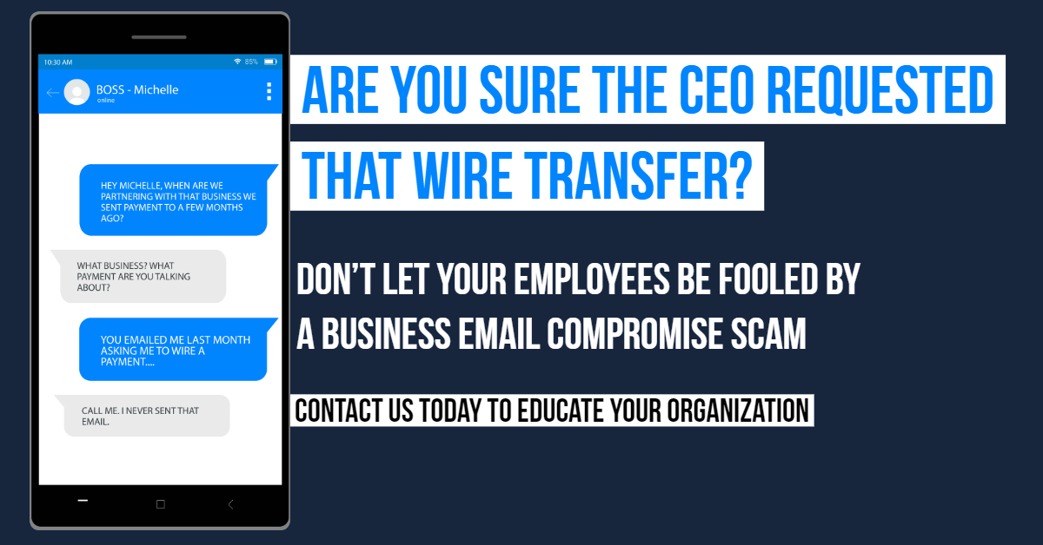
YOUR COMPANY NAME | COMPANY PHONE
COMPANY URL
Notes:
1.Edit Company Name and Company Phone. Add your email address if you’d like.
You may want to highlight your Company Name and Company Phone if you feel it’s difficult to see.
2. Replace “Your Logo Here” with your Company Logo.
3. Once finished, go to:
1. File → Save As
2. Save as .jpeg
3. Share your ad all over social media and link to your branded landing page!

